Slide 1
IBM InfoSphere Information Server
Lesson 4: Various DataStage Stages and Examples

Slide 2
Lesson Objectives
On completion of this lesson, you will be able to:
Type of Stages
Accessing Sequential Data
Reading and Writing NULL Values to a Sequential File
DataSet Stage
Combining Data (Lookup,Join,Merge,Funnel)
Sorting, Aggregating Data And Remove Duplicates(Sort,Aggregator,Remove Duplicates)
Transforming Data
Connectors Stages (Oracle, DB2)
Building SQL to Write to a Table
Change Capture Stage

Slide 3
Types Of Stages

Slide 4
Design Elements of Parallel Jobs
Stages
Implemented as OSH operators (pre-built components)
Passive stages (E and L of ETL)
Read data
Write data
•E.g., Sequential File, DB2, Oracle, Peek stages
Processor (active) stages (T of ETL)
Transform data
Filter data
Aggregate data
Generate data
Split / Merge data
E.g., Transformer, Aggregator, Join, Sort stages
Links
“Pipes” through which the data moves from stage to stage

Slide 5
Accessing Sequential Data

Slide 6
Unit objectives
After completing this unit, you should be able to:
Understand the stages for accessing different kinds of file data
Sequential File stage
Data Set stage
Create jobs that read from and write to sequential files
Create Reject links
Work with NULLs in sequential files
Read from multiple files using file patterns
Use multiple readers

Slide 7
Types of File Data
Sequential
–Fixed or variable length
Data Set
Complex flat file
Several stages handle sequential data. Each stage has both advantages and differences from the other stages that handle sequential data.
Sequential data can come in a variety of types -- including both fixed length and variable length.

Slide 8
How Sequential Data is Handled
Import and export operators are generated
Stages get translated into operators during the compile
Import operators convert data from the external format, as described by the Table Definition, to the framework internal format
Internally, the format of data is described by schemas
Export operators reverse the process
Messages in the job log use the “import” / “export” terminology
E.g., “100 records imported successfully; 2 rejected”
E.g., “100 records exported successfully; 0 rejected”
Records get rejected when they cannot be converted correctly during the import or export

Slide 9

Using the Sequential File Stage
Both import and export of sequential files (text, binary) can be performed by the SequentialFile Stage.
– Data import:
– Data export:
When data is imported the imported operator translates that data into the framework internal format. The export operator performs the reverse action.
Internal format
Internal format

Slide 10
Features of Sequential File Stage
Normally executes in sequential mode
Executes in parallel when reading multiple files
Can use multiple readers within a node
Reads chunks of a single file in parallel
The stage needs to be told:
How file is divided into rows (record format)
How row is divided into columns (column format)

Slide 11
Sequential File Format Example
Record delimiter
Field 1
,
Field 2
,
Field 3
,
Last field
nl
Final Delimiter = end
Field Delimiter
Field 1
,
Field 2
,
Field 3
,
Last field
,
nl
Final Delimiter = comma
This shows the format of one type of sequential file. Delimiters separate columns. Fields all columns are defined my delimiters. Similarly, records are defined by terminating characters.

Slide 12
Sequential File Stage Rules
One input link
One stream output link
Optionally, one reject link
Will reject any records not matching metadata in the column definitions
Example: You specify three columns separated by commas, but the row that’s read had no commas in it
Example: The second column is designated a decimal in the Table Definition, but contains alphabetic characters

Slide 13
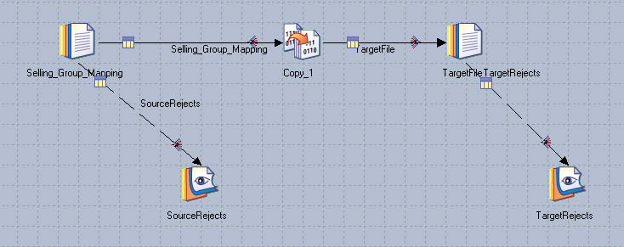
Job Design Using Sequential Stages
Stream link
Reject link (broken line)
The source Sequential stage has a stream output link and a reject output link. The target Sequential stage has an input link and a reject, output link.

Slide 14
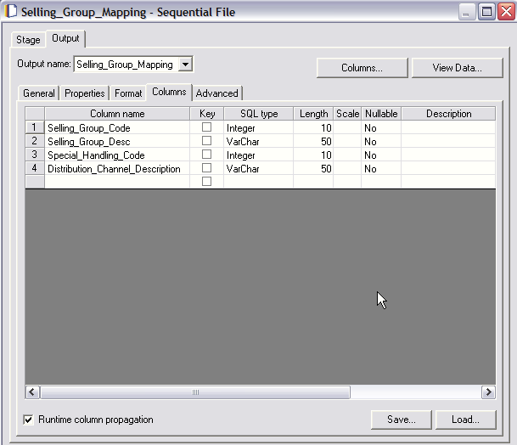
Sequential Source Columns Tab
View Data
Column Definition
Load Table
Definition
Save as a new Table Definition

Slide 15
Sequential Source Columns Tab
The Columns tab has these features:
Column definitions,
View Data,
Load button.
Save button
The Save button is used to save the column definitions into the Repository as a new Table Definition.

Slide 16
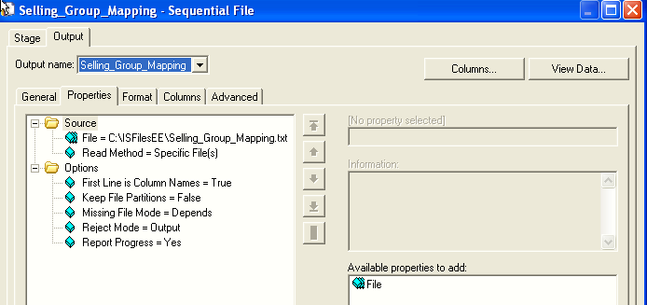
Input Sequential Stage Properties
Output tab
File to access
Column names in first row
Click to add more files to read

Slide 17
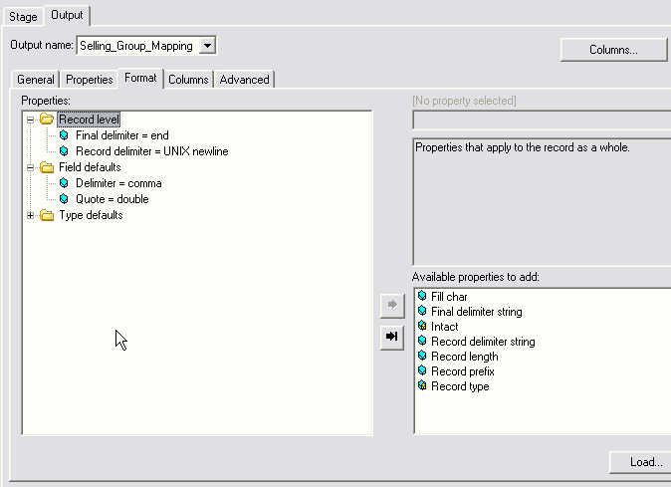
Format Tab
DataStage needs to know:
How a file is divided into rows
How a row is divided into columns
Column properties set on this tab are defaults for each column; they can be overridden at the column level (from columns tab).
Record format
Column format

Slide 18
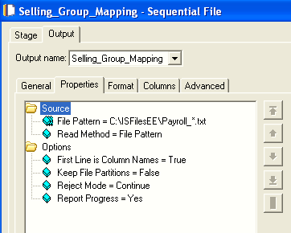
Reading Using a File Pattern
Use wild cards
Select File Pattern

Slide 19
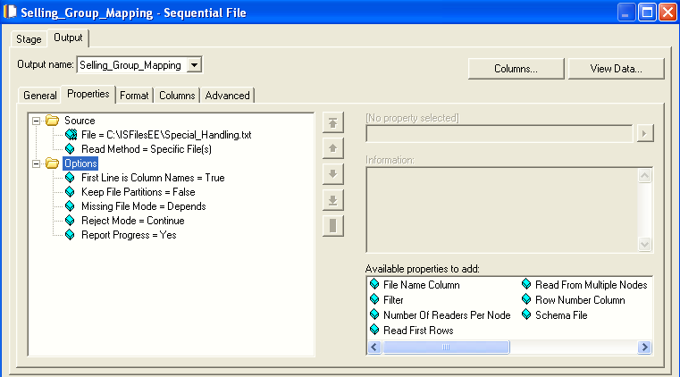
Properties - Multiple Readers
Multiple readers option allows you to set number of readers per node

Slide 20
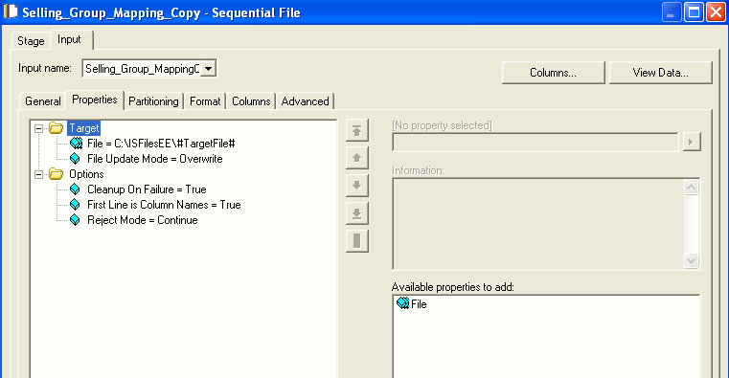
Sequential Stage As a Target
Input Tab
Append / Overwrite

Slide 21
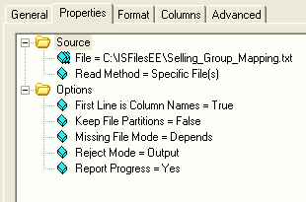
Reject Link
Reject mode =
Continue: Continue reading records
Fail: Abort job
Output: Send down output link
In a source stage
All records not matching the metadata (column definitions) are rejected
In a target stage
All records that fail to be written for any reason
Rejected records consist of one column, datatype = raw
Reject mode property

Slide 22
Reject Link
The sequential stage can have a single reject link.
This is typically used when you are writing to a file and provides a location where records that have failed to be written to a file for some reason can be sent.
When you are reading files, you can use a reject link as a destination for rows that do not match the expected column definitions.

Slide 23
Reading and Writing Null Values

Slide 24
Working with NULLs
Internally, NULL is represented by a special value outside the range of any existing, legitimate values
If NULL is written to a non-nullable column, the job will abort
Columns can be specified as nullable
NULLs can be written to nullable columns
You must “handle” NULLs written to nullable columns in a Sequential File stage
You need to tell DataStage what value to write to the file
Unhandled rows are rejected
In a Sequential File source stage, you can specify values you want DataStage to convert to NULLs

Slide 25
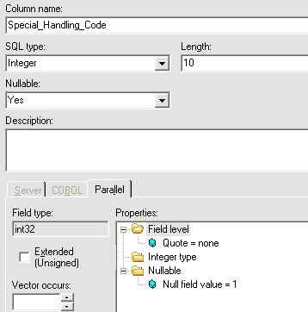
Specifying a Value for NULL
Nullable column
Added property

Slide 26
Dataset

Slide 27
Data Set
Binary data file
Preserves partitioning
Component dataset files are written to each partition
Suffixed by .ds
Referred to by a header file
Managed by Data Set Management utility from GUI (Manager, Designer, Director)
Represents persistent data maintained in the internal format
Key to good performance in set of linked jobs
No import / export conversions are needed
No repartitioning needed

Slide 28
Data Set
Accessed using DataSet stage
Implemented with two types of components:
Descriptor file:
contains metadata, data location, but NOT the data itself
Data file(s)
contain the data
multiple files, one per partition (node)

Slide 29
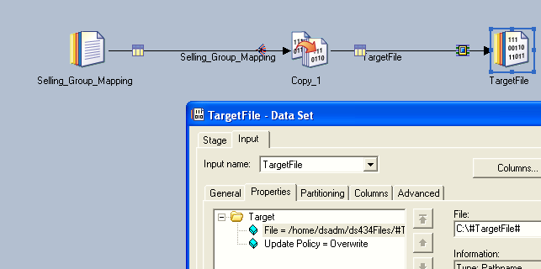
Job With DataSet Stage

Slide 30
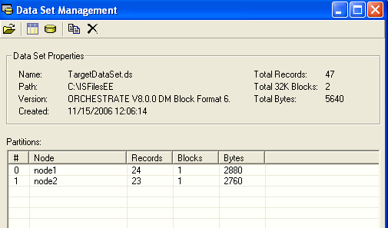
Data Set Management Utility
The window is available (data sets management) from Designer and Director.
In Designer, click Tools>Data Set Management to open this window.

Slide 31
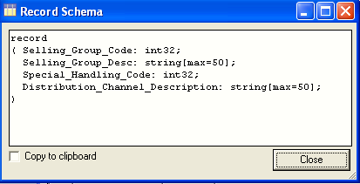
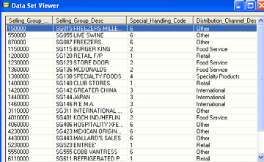
Data and Schema Displayed
Data viewer
Schema describing the format of the data

Slide 32
File Set Stage
Use to read and write to filesets
Files suffixed by .fs
Files are similar to a dataset
Partitioned
Implemented with header file and data files
How filesets differ from datasets
Data files are text files
Hence readable by external applications
Datasets have a proprietary data format which may change in future DataStage versions
Number of raw data files depends on: the configuration file.

Slide 33
Q&A
List three types of file data?
What makes datasets perform better than other types of files in parallel jobs?
What is the difference between a data set and a file set? ?

Slide 34
Q&A
Sequential, dataset, complex flat files
They are partitioned and they store data in the native parallel format
Both are partitioned. Data sets store data in a binary format not readable by user applications. File sets are readable.

Slide 35
Dataset Stage summary
Having completed this unit, you should be able to:
Understand the stages for accessing different kinds of file data
Sequential File stage
Data Set stage
Create jobs that read from and write to sequential files
Create Reject links
Work with NULLs in sequential files
Read from multiple files using file patterns
Use multiple readers

Slide 36
Combining Data

Slide 37
Unit objectives
After completing this unit, you should be able to:
Combine data using the Lookup stage
Combine data using Merge stage
Combine data using the Join stage
Combine data using the Funnel stage

Slide 38
Combining Data
Ways to combine data:
Horizontally:
Multiple input links
One output link made of columns from different input links.
Joins
Lookup
Merge
Vertically:
One input link, one output link combining groups of related records into a single record
Aggregator
Remove Duplicates
Funneling: Multiple input streams funneled into a single output stream
Funnel stage

Slide 39
Lookup, Merge, Join Stages
These stages combine two or more input links
Data is combined by designated "key" column(s)
These stages differ mainly in:
Memory usage
Treatment of rows with unmatched key values
Input requirements (sorted, de-duplicated)

Slide 40
Not all Links are Created Equal
DataStage distinguishes between:
- The Primary input: (Framework port 0)
- Secondary inputs: in some cases "Reference" (other Framework ports)
Conventions:
Tip: Check “Link Ordering" tab to make sure intended Primary is listed first

Slide 41
Lookup Stage

Slide 42
Lookup Features
One stream input link (source link)
Multiple reference links
One output link
Lookup failure options
–Continue, Drop, Fail, Reject
Reject link
Only available with Reject lookup failure option
Can return multiple matching rows
Hash file is built in memory from the lookup files
Indexed by key
Should be small enough to fit into physical memory

Slide 43
Lookup Types
Equality match
Match exactly values in the lookup key column of the reference link to selected values in the source row
Return row or rows (if multiple matches are to be returned) that match
Caseless match
Like an equality match except that it’s caseless
E.g., “abc” matches “AbC”
Range on the reference link
Two columns on the reference link define the range
A match occurs when a selected value in the source row is within the range
Range on the source link
Two columns on the source link define the range
A match occurs when a selected value in the reference link is within the range

Slide 44
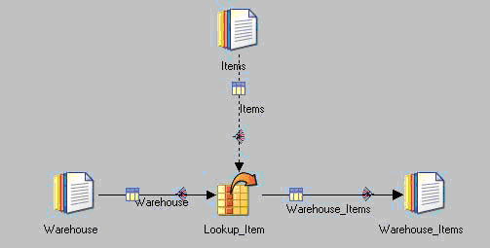
Lookup Example
Source (stream) link
Reference link

Slide 45
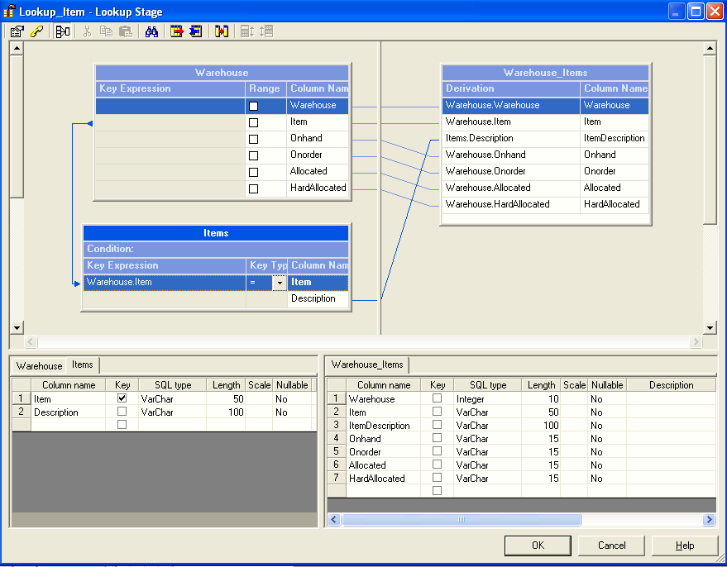
Lookup Stage With an Equality Match
Source link columns
Lookup constraints
Mappings to output columns
Reference key column and source mapping
Column definitions

Slide 46
Lookup Failure Actions
If the lookup fails to find a matching key column, one of several actions can be taken:
Fail (Default)
Stage reports an error and the job fails immediately
Drop
Input row is dropped
Continue
Input row is transferred to the output. Reference link columns are filled with null or default values
Reject
Input row sent to a reject link
This requires that a reject link has been created for the stage

Slide 47
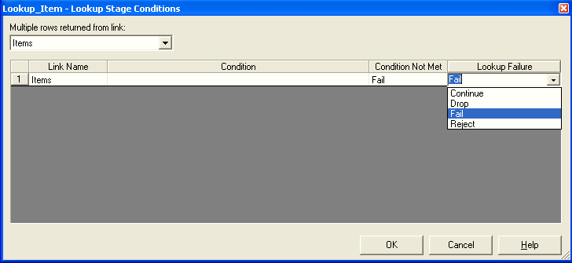
Specifying Lookup Failure Actions
If the lookup fails to find a matching key column, one of several actions can be taken:
Fail (Default)
Stage reports an error and the job fails immediately
Drop
Input row is dropped
Continue
Input row is transferred to the output. Reference link columns are filled with null or default values
Reject
Input row sent to a reject link
This requires that a reject link has been created for the stage
Select to return multiple rows
Select lookup failure action

Slide 48
Lookup Stage Behavior
We shall first use a simplest case, optimal input:
Two input links: “Source" as primary, “Look up" as secondary
sorted on key column (here "Citizen"),
without duplicates on key
Source link (primary input)
Lookup link (secondary input)
Citizen Exchange
M_B_Dextrous | Nasdaq
Righty | NYSE
Revolution Citizen
1789 | Lefty
1776 | M_B_Dextrous
Lookup key column
Notes:
Click the Constraints icon (top, second from left) to open this window.

Slide 49
Lookup Stage
Output of Lookup with Continue option
Output of Lookup with Drop option
Revolution Citizen Exchange
1789 | Lefty
1776 | M_B_Dextrous | Nasdaq
Revolution Citizen Exchange
1776 | M_B_Dextrous | Nasdaq
Notes:
For the first source row (1789), the lookup fails to find a match.
Since Continue is the lookup failure option, the row is output.
The Exchange column is populated with NULL (if the column is nullable) or a default value, empty string (if the column is not nullable).
For the second source row (1776), the lookup finds a match, so the Exchange column gets a value from the lookup file.
When Drop is the lookup failure action, the first, unmatched row is dropped.

Slide 50
The Lookup Stage
Lookup Tables should be small enough to fit into physical memory
On a MPP you should partition the lookup tables using entire partitioning method or partition them by the same hash key as the source link
Entire results in multiple copies (one for each partition)
On a SMP, choose entire or accept the default (which is entire)
Entire does not result in multiple copies because memory is shared

Slide 51
Join Stage

Slide 52
Join Stage
Four types:
Inner
Left outer
Right outer
Full outer
2 or more sorted input links, 1 output link
"left" on primary input, "right" on secondary input
Pre-sort make joins "lightweight": few rows need to be in RAM
Follow the RDBMS-style relational model
Cross-products in case of duplicates
Matching entries are reusable for multiple matches
Non-matching entries can be captured (Left, Right, Full)
No fail/reject option for missed matches

Slide 53
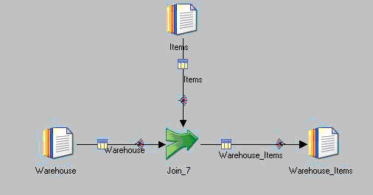
Job With Join Stage
Right input link
Left input link
Join stage

Slide 54
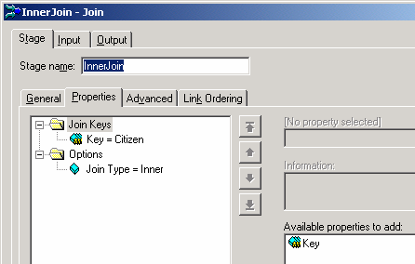
Join Stage Editor
Select left input link
Link Order immaterial for Inner and Full Outer Joins, but very important for Left/Right Outer joins)
Column to match
Select if multiple columns make up the join key
One of four variants:
Inner
Left Outer
Right Outer
Full Outer
Select join type
Multiple key columns allowed

Slide 55
Join Stage Behavior
We shall first use a simplest case, optimal input:
two input links: "left" as primary, "right" as secondary
sorted on key column (here "Citizen"),
without duplicates on key
Left link (primary input)
Right link (secondary input)
Revolution Citizen
1789 | Lefty
1776 | M_B_Dextrous
Citizen Exchange
M_B_Dextrous | Nasdaq
Righty | NYSE
Join key column

Slide 56
Inner Join
Transfers rows from both data sets whose key columns have matching values
Treats both inputs symmetrically
Output of inner join on key Citizen
Revolution Citizen Exchange
1776 | M_B_Dextrous | Nasdaq

Slide 57
Left Outer Join
Transfers all values from the left link and transfers values from the right link only where key columns match
Revolution (Left Record) Citizen Exchange
1789 | Lefty
1776 | M_B_Dextrous | Nasdaq

Slide 58
Right Outer Join
Transfers all values from the right link and transfers values from the left link only where key columns match.
Revolution (Right record) Citizen Exchange
1776 | M_B_Dextrous | Nasdaq
 | Righty | NYSE
Null or default value

Slide 59
Full Outer Join
Transfers rows from both data sets, whose key columns contain equal values, to the output link.
It also transfers rows, whose key columns contain unequal values, from both input links to the output link.
Treats both input symmetrically.
Creates new columns, with new column names!
Revolution (left record) Citizen (right record) Citizen Exchange
1789 | Lefty
1776 | M_B_Dextrous | M_B_Dextrous | Nasdaq
 |  | Righty | NYSE

Slide 60
Merge Stage

Slide 61
Merge Stage
Similar to Join stage
Input links must be sorted
Master link and one or more secondary links
Master must be duplicate-free
Light-weight
Little memory required, because of the sort requirement
Unmatched master rows can be kept or dropped
Unmatched secondary links can be captured in a reject link

Slide 62
More on Merge Stage
Combines
one sorted, duplicate-free master (primary) link with
one or more sorted update (secondary) links.
Pre-sort makes merge "lightweight“ for memory
Follows the Master-Update model:
Master row and one or more updates row are merged iff they have the same value in user-specified key column(s).
Unmatched ("Bad") master rows can be either
kept ([-keepBadMasters])
dropped (-dropBadMasters)
Unmatched ("Bad") update rows in input link n can be captured in a "reject" link in corresponding output link n.
Matched update rows are consumed

Slide 63
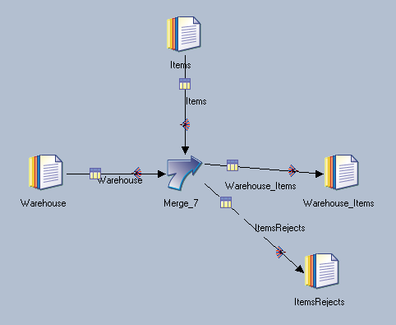
Merge Stage Job
Merge stage
Capture update link non-matches

Slide 64
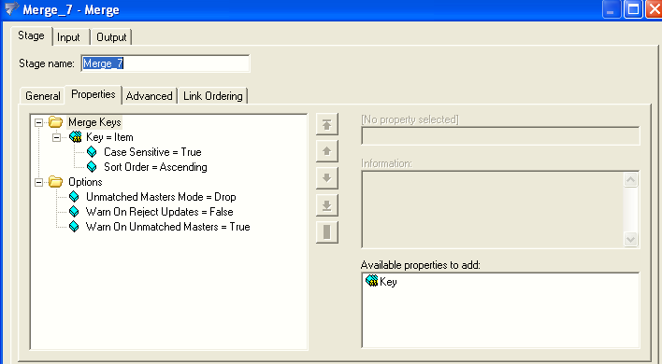
Merge Stage Properties
Match key
Keep or drop unmatched masters
Notes:
Unmatched updates are captured by adding additional reject links (one for each update link).
Unmatched Master rows
One of two options:
Keep [default]
Drop
(Capture in reject link is NOT an option)
Unmatched Update rows option:
Capture in reject link(s). Implemented by adding outgoing links

Slide 65
Merge Options
keepBadMaster
Same output as left outer join and lookup/continue
dropBadMaster
Both options yield the same "reject" link of "bad" (unused) updates

Slide 66
Comparison: Joins, Lookup, Merge

Slide 67
Funnel Stage

Slide 68
What is a Funnel Stage?
Combines data from multiple input links to a single output link
All sources must have identical meta data
Three modes
Continuous
Records are combined in no particular order
First available record
It takes one record from each input link in turn. If data is not available on an input link, the stage skips to the next link rather than waiting.
Does not attempt to impose any order on the data it is processing Sort Funnel
Combines the input records in the order defined by a key
Produces sorted output if the input links are all sorted by the same key
Sequence:
Outputs all records from the first input link, then all from the second input link, and so on

Slide 69
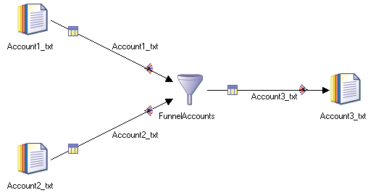
Funnel Stage Example

Slide 70
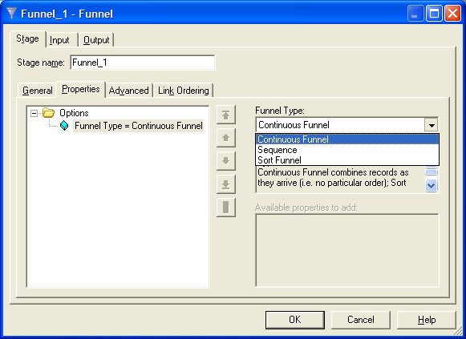
Funnel Stage Properties

Slide 71
Q&A
Name three stages that horizontally join data?
Which stage uses the least amount of memory? Join or Lookup?
Which stage requires that the input data is sorted? Join or Lookup?

Slide 72
Q&A
Lookup, Merge, Join
Lookup
Join

Slide 73
Unit summary
Having completed this unit, you should be able to:
Combine data using the Lookup stage
Define range lookups
Combine data using Merge stage
Combine data using the Join stage
Combine data using the Funnel stage

Slide 74
Sorting and Aggregating Data

Slide 75
Unit objectives
After completing this unit, you should be able to:
Sort data using in-stage sorts and Sort stage
Combine data using Aggregator stage
Combine data Remove Duplicates stage

Slide 76
Sort Stage

Slide 77
Sorting Data
Uses
Some stages require sorted input
Join, merge stages require sorted input
Some stages use less memory with sorted input
E.g., Aggregator
Sorts can be done:
Within stages
On input link Partitioning tab, set partitioning to anything other than Auto
In a separate Sort stage
Makes sort more visible on diagram
Has more options

Slide 78
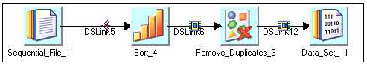
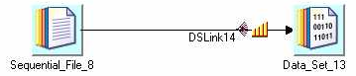
Sorting Alternatives
Sort stage
Sort within
stage

Slide 79
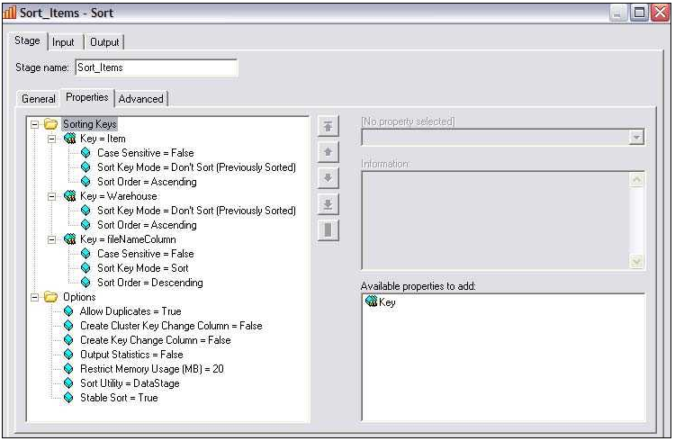
Sort Stage
Sort key
Sort options

Slide 80
Sort keys
Add one or more keys
Specify sort mode for each key
Sort: Sort by this key
Don’t sort (previously sorted):
Assumes the data has already been sorted on this key
Continue sorting by any secondary keys
Specify sort order: ascending / descending
Specify case sensitive or not

Slide 81
Sort Options
Sort Utility
DataStage – the default
Unix: Don’t use. Slower than DataStage sort utility
Stable
Allow duplicates
Memory usage
Sorting takes advantage of the available memory for increased performance
Uses disk if necessary
Increasing amount of memory can improve performance
Create key change column
Add a column with a value of 1 / 0
1 indicates that the key value has changed
0 means that the key value hasn’t changed
Useful for processing groups of rows in a Transformer

Slide 82
Partitioning V. Sorting Keys
Partitioning keys are often different than Sorting keys
Keyed partitioning (e.g., Hash) is used to group related records into the same partition
Sort keys are used to establish order within each partition
Example:
Partition on HouseHoldID, sort on HouseHoldID, EntryDate
Partitioning on HouseHoldID ensures that the same ID will not be spread across multiple partitions
Sorting orders the records with the same ID by entry date
Useful for deciding which of a group of duplicate records with the same ID should be retained

Slide 83
Aggregator Stage

Slide 84

Aggregator Stage
Purpose: Perform data aggregations
Specify:
One or more key columns that define the aggregation units (or groups)
Columns to be aggregated
Aggregation functions include, among many others:
count (nulls/non-nulls)
Sum
Max / Min
The grouping method (hash table or pre-sort) is a
performance issue

Slide 85
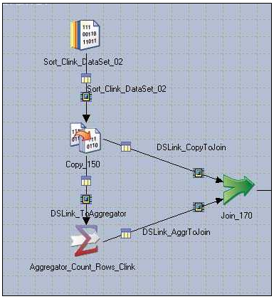
Job with Aggregator Stage
Aggregator
stage

Slide 86
Aggregation Types
Count rows
Count rows in each group
Put result in a specified output column
Calculation
Select column
Put result of calculation in a specified output column
Calculations include:
Sum
Count
Min, max
Mean
Missing value count
Non-missing value count
Percent coefficient of variation

Slide 87
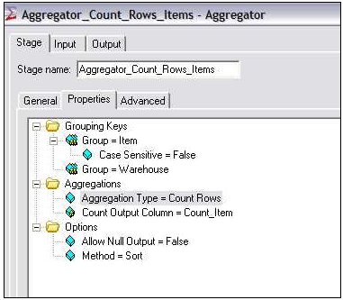
Count Rows Aggregator Properties
Grouping key
columns
Output column for
the result
Count Rows
aggregation type

Slide 88
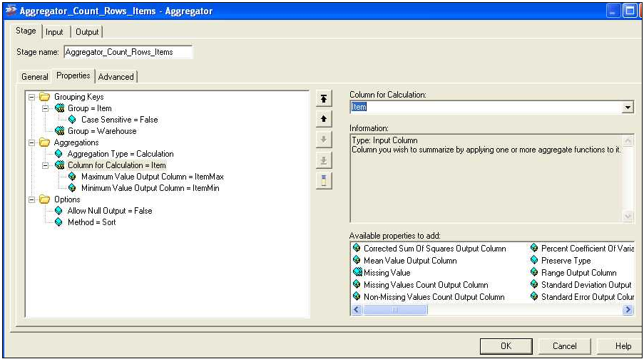
Calculation Type Aggregator Properties
Grouping key
columns
Calculation
aggregation type
Calculations with
output columns
Available
calculations

Slide 89
Grouping Methods
Hash (default)
Calculations are made for all groups and stored in memory
Hash table structure (hence the name)
Results are written out after all input has been processed
Input does not need to be sorted
Useful when the number of unique groups is small
Running tally for each group’s aggregations needs to fit into memory
Sort
Requires the input data to be sorted by grouping keys
Does not perform the sort! Expects the sort
Only a single aggregation group is kept in memory
When a new group is seen, the current group is written out
Can handle unlimited numbers of groups

Slide 90
Removing Duplicates

Slide 91
Removing Duplicates
Can be done by Sort stage
Use unique option
No choice on which duplicate to keep
Stable sort always retains the first row in the group
Non-stable sort is indeterminate
OR
Remove Duplicates stage
Has more sophisticated ways to remove duplicates
Can choose to retain first or last

Slide 92
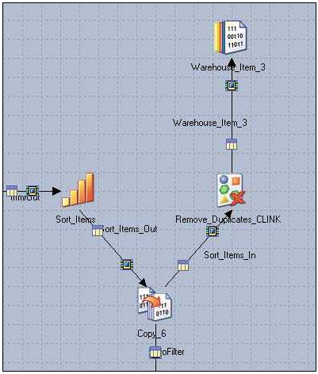
Remove Duplicates Stage Job
Remove Duplicates
stage

Slide 93
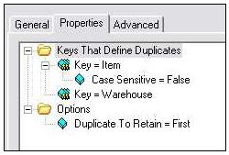
Remove Duplicates Stage Properties
Key that defines
duplicates
Retain first or last
duplicate

Slide 94
Q&A
What stage is used to perform calculations of column values grouped in specified ways?
In what two ways can sorts be performed?
What is a stable sort?

Slide 95
Q&A
Aggregator stage
Using the Sort stage. In-stage sorts.
Stable sort preserves the order of non-key values.

Slide 96
Unit summary
Having completed this unit, you should be able to:
Sort data using in-stage sorts and Sort stage
Combine data using Aggregator stage
Combine data Remove Duplicates stage

Slide 97
Transforming Data

Slide 98
Unit objectives
After completing this unit, you should be able to:
Use the Transformer stage in parallel jobs
Define constraints
Define derivations
Use stage variables
Create a parameter set and use its parameters in constraints and derivations

Slide 99
Transformer Stage

Slide 100
Transformer Stage
BASIC Transformer stage
The BASIC Transformer stage is a processing stage.
It appears under the processing category in the tool palette in the Transformer shortcut container.
The BASIC Transformer stage is similar in appearance and function to the Transformer stage described in Transformer stage. It gives access to BASIC transforms and functions (BASIC is the language supported by the server engine and available in server jobs).
You can only use BASIC transformer stages on SMP systems (not on MPP or cluster systems).
BASIC Transformer stages can have a single input and any number of outputs
Notes:
In this module, we’ll discuss two stages that can be used to perform derivations to implement business logic. Our main focus in on the Transformer stage. We’ll also briefly discuss the Modify stage.

Slide 101
Transformer Stage
Transformer stage
The Transformer stage is a processing stage.
It appears under the processing category in the tool palette.
Transformer stages allow you to create transformations to apply to your data.
These transformations can be simple or complex and can be applied to individual columns in your data.
Transformations are specified using a set of functions.
Transformer stages can have a single input and any number of outputs. It can also have a reject link that takes any rows which have not been written to any of the outputs links by reason of a write failure or expression evaluation failure.
Notes:
In this module, we’ll discuss two stages that can be used to perform derivations to implement business logic. Our main focus in on the Transformer stage. We’ll also briefly discuss the Modify stage.

Slide 102
Transformer Stage
Column mappings
Derivations
Written in Basic
Final compiled code is C++ generated object code
Constraints
Filter data
Direct data down different output links
For different processing or storage
Expressions for constraints and derivations can reference
Input columns
Job parameters
Functions
System variables and constants
Stage variables
External routines
Notes:
In this module, we’ll discuss two stages that can be used to perform derivations to implement business logic. Our main focus in on the Transformer stage. We’ll also briefly discuss the Modify stage.

Slide 103
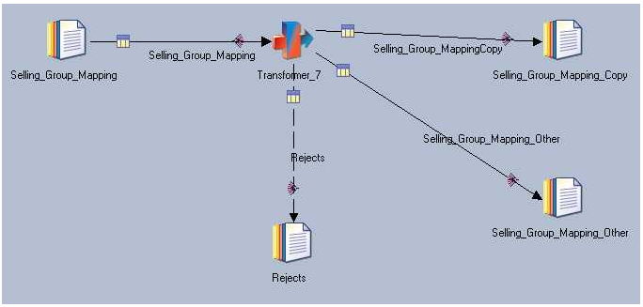
Job With a Transformer Stage
Transformer
Single input
Multiple outputs
Reject link

Slide 104
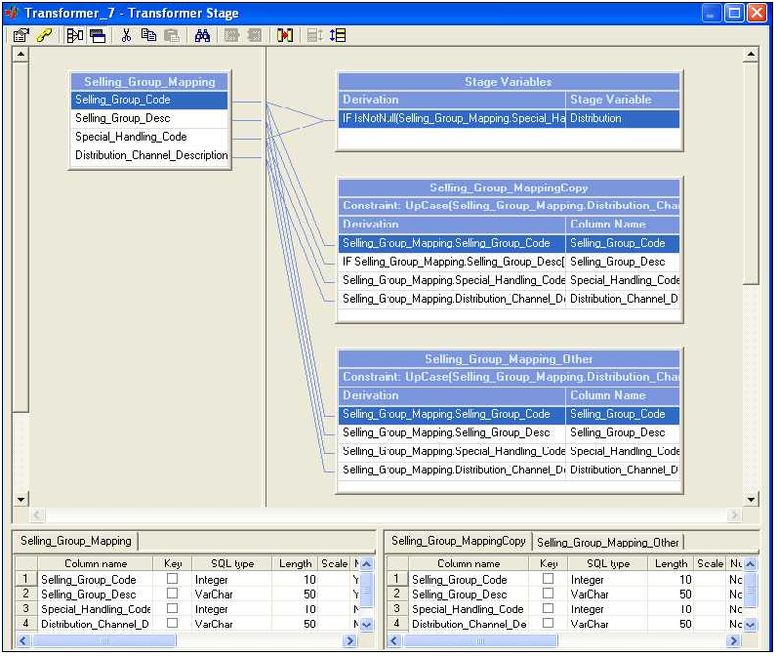
Inside the Transformer Stage
Stage variables
Show/Hide
Input columns
Constraint
Derivations / Mappings
Column definitions
Output columns
Notes:
Link naming conventions are important because they identify appropriate links in the stage properties screen shown above.
Four quadrants:
Incoming data link (one only)
Outgoing links (can have multiple)
Meta data for all incoming links
Meta data for all outgoing links – may have multiple tabs if there are multiple outgoing links
Note the constraints bar – if you double-click on any you will get screen for defining constraints for all outgoing links.
Double-click to the left of an output column or stage variable to define its derivation.

Slide 105
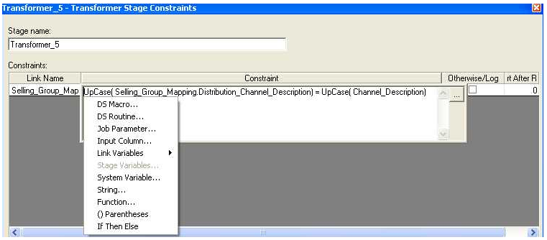
Defining a Constraint
Input column
Function
Job parameter
Notes:
Click the Constraints icon at the top of the Transformer (yellow chain) to open the Constraints window.
Select items from the menu or type in items to build the expression.

Slide 106
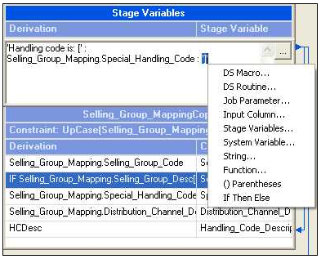
Defining a Derivation
Concatenation
operator (:)
Input column
String in quotes

Slide 107
IF THEN ELSE Derivation
Use IF THEN ELSE to conditionally derive a value
Format:
IF <condition> THEN <expression1> ELSE <expression1>
If the condition evaluates to true then the result of expression1 will be copied to the target column or stage variable
If the condition evaluates to false then the result of expression2 will be copied to the target column or stage variable
Example:
Suppose the source column is named In.OrderID and the target column is named Out.OrderID
Replace In.OrderID values of 3000 by 4000
IF In.OrderID = 3000 THEN 4000 ELSE Out.OrderID

Slide 108
String Functions and Operators
Substring operator
Format: “String” [loc, length]
Example:
Suppose In.Description contains the string “Orange Juice”
InDescription[8,5] “Juice”
UpCase(<string>) / DownCase(<string>)
Example: UpCase(In.Description) “ORANGE JUICE”
Len(<string>)
Example: Len(In.Description) 12

Slide 109
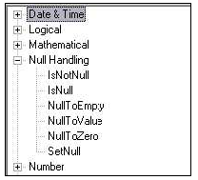
Checking for NULLs
Nulls can be introduced into the data flow from lookups
Mismatches (lookup failures) can produce nulls
Can be handled in constraints, derivations, stage variables, or a combination of these
NULL functions
Testing for NULL
IsNull(<column>)
IsNotNull(<column>)
Replace NULL with a value
NullToValue(<column>, <value>)
Set to NULL: SetNull()
Example: IF In.Col = 5 THEN SetNull() ELSE In.Col
Notes:
If you perform a lookup from a lookup stage and choose the continue option for a failed lookup, you have the possibility of nulls entering your data flow.
Important: Be sure to use the NULL functions in stage variable derivations rather than output column derivations. Reference the stage variable in column derivations rather than performing the NULL function in the column derivation. The reason for this is that records containing NULLs are rejected BEFORE column derivations are performed (but not before stage variable derivations are performed).

Slide 110
Transformer Functions
Date & Time
Logical
Null Handling
Number
String
Type Conversion

Slide 111
Transformer Execution Order
Derivations in stage variables
Constraints are executed before derivations
Column derivations in earlier links are executed before later links
Derivations in higher columns are executed before lower columns

Slide 112
Transformer Stage Variables
Derivations execute in order from top to bottom
Later stage variables can reference earlier stage variables
Earlier stage variables can reference later stage variables
These variables will contain a value derived from the previous row that came into the Transformer
Multi-purpose
Counters
Store values from previously read rows to make comparisons with the currently read row
Store derived values to be used in multiple target field derivations
Can be used to control execution of constraints

Slide 113
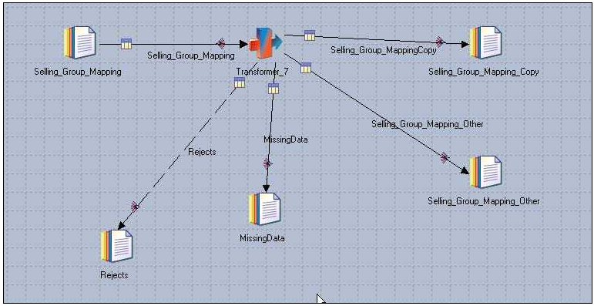
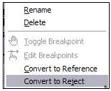
Transformer Reject Links
Reject link
Convert link to a
Reject link
Notes:
Rows are sent to the Reject link if a nullable column is used in a calculation or derivation and that column has a NULL value.
It is important to test for and replace NULLs in any derivations that reference nullable input columns.
Position these tests for and replaces of NULLs within stage variable derivations.

Slide 114
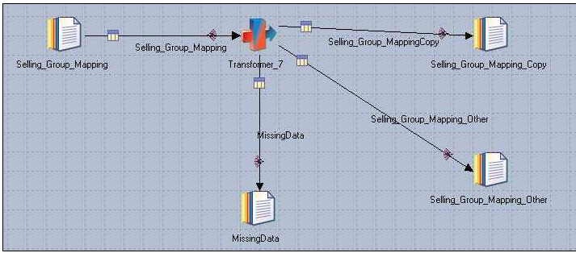
Otherwise Link
Otherwise link
Notes:
The otherwise link captures what doesn’t go down any previous links.
It needs to come after the other links in the link ordering.
It’s defined on the Constraints tab, as shown in the next slide.

Slide 115
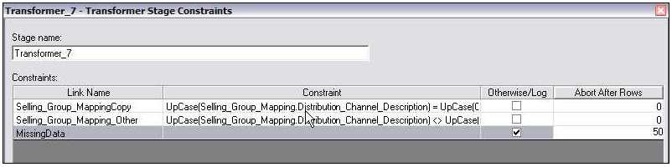
Defining an Otherwise Link
Check to create otherwise condition
Can specify abort
condition
Notes:
The Otherwise link must come after the other links carrying the main constraints. You can change the ordering of links, as shown on the next slide. A warning is put in the log if any rows go down the otherwise link. You can specify an abort condition for any output link. The abort occurs after the specified number of rows occurs in one of the partitions. It is not based on the total number of rows, but on the number of rows in a single partition.

Slide 116
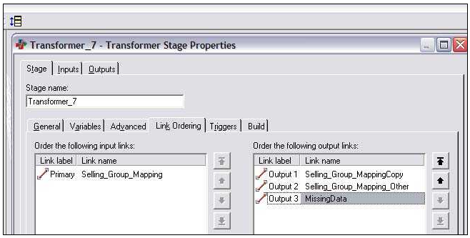
Specifying Link Ordering
Link ordering toolbar icon
Last in
order
Notes:
The Link Ordering icon is at the last icon on the toolbar.

Slide 117
Q & A
What occurs first? Derivations or constraints?
Can stage variables be referenced in constraints?
Where should you test for NULLS within a Transformer? Stage Variable derivations or output column derivations?

Slide 118
Q & A
Constraints
Yes
Stage variable derivations. Reference the stage variables in the output column derivations.

Slide 119
Unit summary
Having completed this unit, you should be able to:
Use the Transformer stage in parallel jobs
Define constraints
Define derivations
Use stage variables
Create a parameter set and use its parameters in constraints and derivations

Slide 120
Connectors Stages

Slide 121
Connector Stage Types
ODBC
Conforms to ODBC 3.5 standard and is Level 3 compliant
Certified with Oracle, DB2 UDB, SQL Server, and others
DataDirect drivers
DB2 UDB
8.1 and 8.2
WebSphere MQ
WSMQ 5.3 and 6.0 for Client / Sever
WSMB 5.0
Teradata

Slide 122
Connector Stage Features
Common stage editor
Convenient drop-down lists to choose properties
Job parameters can be inserted into any property
Required properties are identified with a visual indicator
Warning indicator for properties requiring attention
Metadata retrieval
Integrated SQL Builder

Slide 123
Connector Stage Features
Parallel support
Read: parallel connections to the server and modified SQL queries for each connection
Write: parallel connections to the server
Transaction isolation level support
Read Uncommitted
Read Committed
Repeatable Read
Serializable
Before / After commands
Executed once before or after the job runs

Slide 124
Metadata Retrieval
List data sources
Can list both user and system DSNs
List users defined for the given database
Individual table or view metadata
Column data type, size, precision, etc.
Database information
Name, vendor name, version number, etc.
List of database schemas
List tables that match the filter criteria
List related tables
Those related by foreign key
Those whose foreign keys point to the primary key in the given table

Slide 125
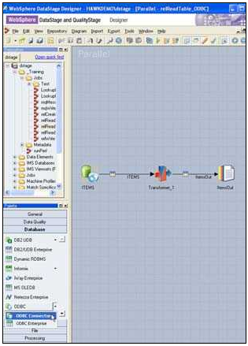
Connector Stages
ODBC connector
ODBC connector

Slide 126
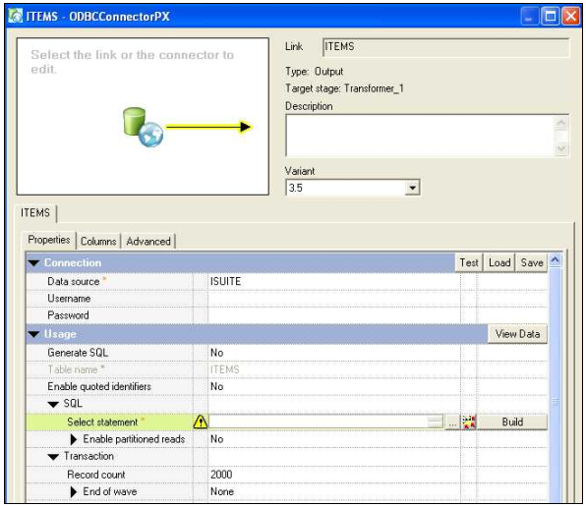
Stage Editor
Navigator panel
Click to display
stage properties
Properties
Click to display link properties and columns

Slide 127
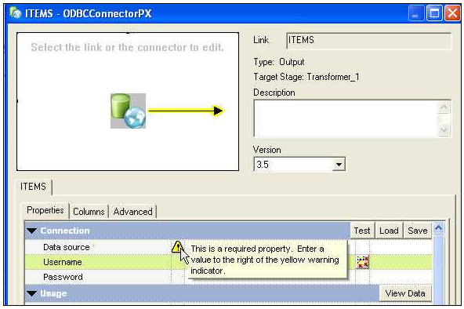
Property Warning Indicators
Warning indicator

Slide 128
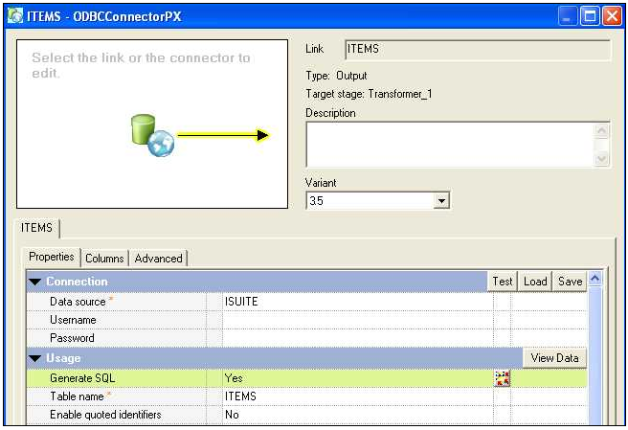
Auto-Generated SQL
Stage generates
SQL SELECT based on column definitions

Slide 129
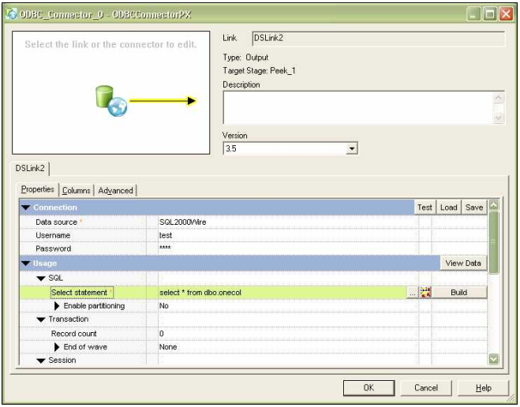
Invoking SQL Builder
SQL statement
property
SQL Builder

Slide 130
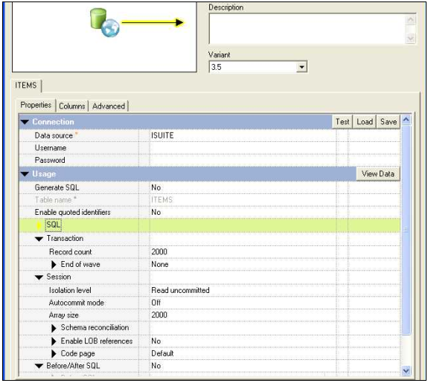
Connector Stage Properties
Connection
information
SQL
Transaction
and session
management
Before/After
the SQL

Slide 131
Building SQL to Write to a Table

Slide 132
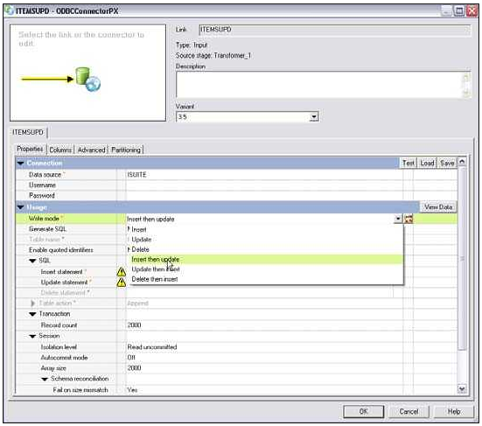
Select Type of Write
Write mode
property

Slide 133
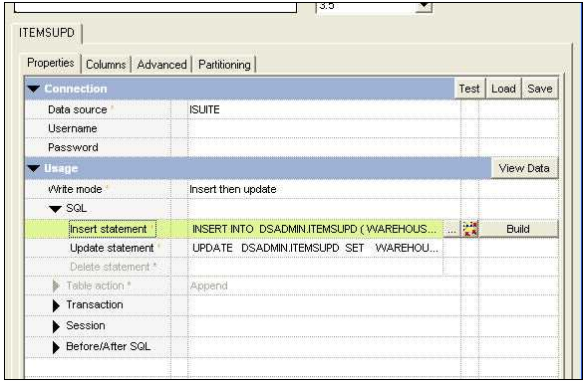
Invoking SQL Builder
Specify
INSERT
Specify
UPDATE
SQL
Builder

Slide 134
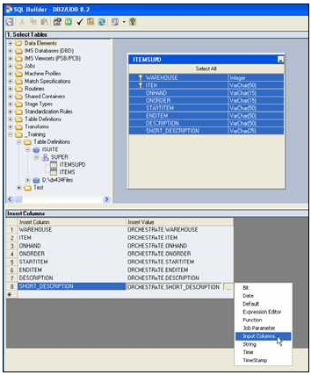
SQL Builder INSERT
Drag Table
Definition
Drag columns to load
Specify
values

Slide 135
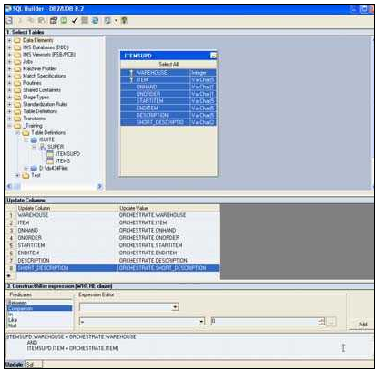
SQL Builder Update
Drag Table
Definition
Drag columns to load
Specify
values
WHERE
clause
Add condition
to clause

Slide 136

Viewing the SQL

Slide 137
Change Capture Stage

Slide 138
Change Capture Stage
The Change Capture Stage is a processing stage.
The stage compares two data sets and makes a record of the differences.
The Change Capture stage takes two input data sets, denoted before and after, and outputs a single data set whose records represent the changes made to the before data set to obtain the after data set.
The stage produces a change data set, whose table definition is transferred from the after data set's table definition with the addition of one column: a change code with values encoding the four actions: insert, delete, copy, and edit.
The preserve-partitioning flag is set on the change data set.

Slide 139
Change Capture Stage
The compare is based on a set a set of key columns, rows from the two data sets are assumed to be copies of one another if they have the same values in these key columns.
Change Capture Stage is used to capture the changes between two sources based on the change code. Change Code is the Code generated when we capture the changes using Change Capture Stage.
There are four change codes available: 0,1,2,3 0 - Copy 1 - Insert 2 - Delete 3 - Edit

